Slide 1
Introducing DevOps and Continuous Integration
Module 5 – Continuous Integration

Slide 2
The term DevOps can be a difficult one to define as different organisations have varying approaches to implementing DevOps.
It is best described as a cultural approach to software development project structure with a particular philosophy designed to achieve the following:
Increased collaboration
Reduction in silos
Shared responsibility
Autonomous teams
Increase in quality
Valuing feedback
Increase in automation
What is DevOps?

Slide 3
Traditionally, software companies are structured as separate, stratified teams for development, quality assurance (sometimes known as testers), security, and operations.
These teams tend to have varying (and sometimes conflicting!) goals which, when paired with poor communication between them, can regularly result in work that is out of sync with other parts of the organisation. These isolated teams are referred to as silos.
As a result, this structure regularly results in slower releases, wasted time (and therefore money), and blame cultures, where production problems become the fault of another team.
IT Before DevOps

Slide 4
DEVOPS AND AUTOMATION: INTEGRATION, DELIVERY AND DEPLOYMENT
Automation around process is a big part of DevOps, and this typically focuses around three main areas:
Continuous Integration - Integration and testing of new features into software
Continuous Delivery – Deploying safe-working code into a staging environment
Continuous Deployment - Deployment of applications to a customer for usage

Slide 5
Continuous Integration, Delivery, Deployment
Continuous Integration
Continuous Delivery
Continuous Deployment
Continuous Integration (CI) is a software dev practice that revolves around merging changes often
Different features are combined, or integrated, frequently to expose issues quickly
Automating the integration of code, the building of software, and testing of software is key
Continuous delivery extends on CI, ensuring that you can release new changes to customers quickly on a schedule
We automate the deployment to a staging environment – an environment that mimics the production environment as closely as possible
Once we’ve verified that it works in this staging environment, it should work in a production environment
Continuous Deployment extends even further on Continuous Delivery, automating deployment into a customer-facing environment
As you can probably assume, this is quite the difficult and stressful task!
If anything is wrong with a feature, it could be seen by customers

Slide 6
Continuous Integration, Delivery, Deployment
Continuous Integration
Continuous Delivery
Continuous Deployment
Continuous Integration (CI) is a software dev practice that revolves around merging changes often
Different features are combined, or integrated, frequently to expose issues quickly
Automating the integration of code, the building of software, and testing of software is key
Continuous delivery extends on CI, ensuring that you can release new changes to customers quickly on a schedule
We automate the deployment to a staging environment – an environment that mimics the production environment as closely as possible
Once we’ve verified that it works in this staging environment, it should work in a production environment
Continuous Deployment extends even further on Continuous Delivery, automating deployment into a customer-facing environment
As you can probably assume, this is quite the difficult and stressful task!
If anything is wrong with a feature, it could be seen by customers

Slide 7
Continuous Integration, Delivery, Deployment
Continuous Integration
Continuous Delivery
Continuous Deployment
Continuous Integration (CI) is a software dev practice that revolves around merging changes often
Different features are combined, or integrated, frequently to expose issues quickly
Automating the integration of code, the building of software, and testing of software is key
Continuous delivery extends on CI, ensuring that you can release new changes to customers quickly on a schedule
We automate the deployment to a staging environment – an environment that mimics the production environment as closely as possible
Once we’ve verified that it works in this staging environment, it should work in a production environment
Continuous Deployment extends even further on Continuous Delivery, automating deployment into a customer-facing environment
As you can probably assume, this is quite the difficult and stressful task!
If anything is wrong with a feature, it could be seen by customers

Slide 8
Exercise 1 – CI research
In groups, research online about a company that utilises DevOps, CI and CD principles within their business
Note down who the business are, what their main trade/service is, etc.
Answer the following questions where possible:
Why did the business adopt CI/CD?
How has it improved their development processes?
What tools do they use that you recognise, if any?
Share your research and thoughts with the rest of the room

Slide 9
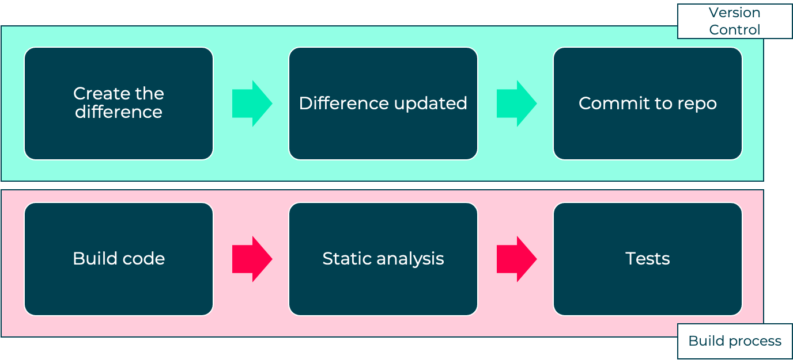
Facebook is one of the biggest social media platforms and has billions of monthly active mobile users
Christian Legnitto discussed the way Facebook developed their mobile platform in 2014
Number of different teams – messages, photos, Android, iOS, events
Have over 100,000 commits to their Git repository
300 contributes with over 150,000 files
CI in Action – Facebook

Slide 10
End of section

